Slide 1

Mock Objects – Drink Mockito
Course “JUnit magic”
Section 5

Slide 2
Agenda
Mock objects
Drink Mockito

Slide 3
MOCK OBJECTS

Slide 4
Mock object definition
In object-oriented programming, mock object are simulated object that mimic the behavior of real object in controlled way.

Slide 5
Why Mock object?
A programmer typically create a mock object to test the behavior of some other object, in much the same way that a car designer uses a crash test dummy to simulate the dynamic behavior of a human in vehicle impacts.

Slide 6
Mock objects vs Stubs
There is a difference in how test results are verified: a distinction between state verification and behavior verification.

Slide 7
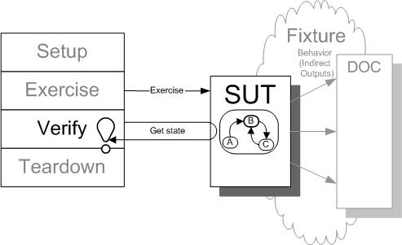
State Verification
Inspect the state of the system under test (SUT) after it has been exercised and compare it to the expected state.
http://xunitpatterns.com/State%20Verification.html

Slide 8
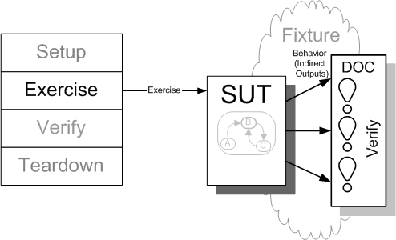
Behavior Verification
Capture the indirect outputs of the SUT as they occur and compare them to the expected behavior.
http://xunitpatterns.com/Behavior%20Verification.html

Slide 9
DRINK MOCKITO

Slide 10
Why drink Mockito?
Mockito is a mocking framework that tastes really good.
It lets you write beautiful tests with clean & simple API.
Mockito doesn't give you hangover because the tests are very readable and they produce clean verification errors.

Slide 11
Quote about Mockito
"We decided during the main conference that we should use JUnit 4 and Mockito because we think they are the future of TDD and mocking in Java"
Dan North,
the originator of
Behavior Driven Development

Slide 12
Mockito first example (source)
public interface CurrentYearProvider {
int getYear();
}
public class CurrentYearProviderImpl implements CurrentYearProvider {
public int getYear() {
return 2011;
}
}

Slide 13
Mockito first example (source)
public class TaxCalculatorImpl {
private CurrentYearProvider currentYearProvider;
public TaxCalculatorImpl(CurrentYearProvider provider) {
this.currentYearProvider = provider;
}
public double calculateTax(double income) {
if(currentYearProvider.getYear() == 2011) {
return income * 0.22;
}
else return income * 0.18;
}
}

Slide 14
Mockito first example (test)
public class TaxCalculatorImplTest {
@Test
public void testCalculateTax_2011() {
CurrentYearProvider currentYearProvider = mock(CurrentYearProvider.class);
TaxCalculatorImpl calculator =
new TaxCalculatorImpl(currentYearProvider);
when(currentYearProvider.getYear()).thenReturn(2011);
double tax = calculator.calculateTax(100);
assertEquals(tax, 22.0, 0.0001);
}
}

Slide 15
Mock object interface (1)
Mock object have the same interface as the real object they mimic, allowing a client object to remain unaware of whether it is using a real object or a mock object.

Slide 16
Mock object interface (2)
import static org.mockito.Mockito.*;
CurrentYearProvider currentYearProvider = mock(CurrentYearProvider.class);
TaxCalculatorImpl calculator =
new TaxCalculatorImpl(currentYearProvider);

Slide 17
Stubbing
import static org.mockito.Mockito.*;
when(currentYearProvider.getYear()).thenReturn(2011);
Note: Once stubbed, the method will always return stubbed value regardless of how many times it is called.

Slide 18
Remarks about stubbing
By default, for all methods that return value, mock returns null, an empty collection or appropriate primitive/primitive wrapper value (e.g: 0, false, ... for int/Integer, boolean/Boolean, ...).

Slide 19
Verify mock interactions
Once created, mock will remember all interactions.
Then you can selectively verify whatever interaction you are interested in.

Slide 20
Let’s verify some behavior!
//Let's import Mockito statically so that the code looks clearer
import static org.mockito.Mockito.*;
//mock creation
List mockedList = mock(List.class);
//using mock object
mockedList.add("one");
mockedList.clear();
//verification
verify(mockedList).add("one");
verify(mockedList).clear();

Slide 21
Verifying exact number of invocations
//using mock
mockedList.add("once");
mockedList.add("twice");
mockedList.add("twice");
//exact number of invocations verification
verify(mockedList, times(1)).add(“once");
verify(mockedList, times(2)).add("twice");
//verification using never(). never() is an alias to times(0)
verify(mockedList, never()).add("never happened");
//verification using atLeast()/atMost()
verify(mockedList, atLeastOnce()).add(“once");
verify(mockedList, atLeast(2)).add(“twice");
verify(mockedList, atMost(2)).add(“twice");

Slide 22
Stubbing void methods with exceptions
doThrow(new RuntimeException()).when(mockedList).clear();
//following throws RuntimeException:
mockedList.clear();

Slide 23
Making sure interactions never happened on mock
//using mocks - only mockOne is interacted
mockOne.add("one");
//ordinary verification
verify(mockOne).add("one");
//verify that method was never called on a mock
verify(mockOne, never()).add("two");
//verify that other mocks were not interacted
verifyZeroInteractions(mockTwo, mockThree);

Slide 24
Argument matchers
//stubbing using built-in anyInt() argument matcher
when(mockedList.get(anyInt())).thenReturn("element");
//following prints "element"
System.out.println(mockedList.get(999));
//you can also verify using an argument matcher
verify(mockedList).get(anyInt());

Slide 25
Other examples
Go to: http://code.google.com/p/mockito/
Select:
documentation and examples

Slide 26

Any Questions?

Slide 27
References
xUnit Test Patterns: Refactoring Test Code: http://martinfowler.com/books.html
Mockito: http://code.google.com/p/mockito/
Martin Fowler “Mocks Aren’t Stubs”: http://martinfowler.com/articles/mocksArentStubs.html

